Slide 1


PROJECT MANAGEMENT
UNIT - IV

Slide 2
Estimating Time Accurately
Unit IV: Project Scheduling and Network Analysis
Time estimates drive the setting of deadlines for delivery of projects, and hence people's assessments of your reliability.
They often determine the pricing of contracts and hence their profitability.
Other high urgency tasks to be carried out which will have priority over this one
Accidents and emergencies
Internal meetings
Holidays and sickness in essential staff
Contact with other customers, perhaps to arrange the next job
Breakdowns in equipment
Missed deliveries by suppliers
Quality control rejections
PROJECT MANAGEMENT
Notes:
Estimating Time Accurately
Accurate time estimation is a skill essential to good project management.
Usually people vastly underestimate the amount of time needed to implement projects. This is true particularly when they are not familiar with the task to be carried out.
They forget to take into account unexpected events or unscheduled high priority work. People also often simply fail to allow for the full complexity involved with a job
You can lose a great deal of credibility by underestimating the length of time needed to implement a project. If you underestimate time, not only do you miss deadlines, you also put other project workers under unnecessary stress. Projects will become seriously unprofitable, and other tasks cannot be started.
The first stage in estimating time accurately is to fully understand what you need to achieve. This involves reviewing the task in detail so that there are no unknowns. Inevitably it is the difficult-to-understand, tricky problems that take the greatest amount of time to solve.
The best way to review the job is to list all tasks in full detail. Once you have a detailed list of all the tasks that you must achieve, make your best guess at how long each task will take to complete.

Slide 3
Scheduling The Project
Unit IV: Project Scheduling and Network Analysis
Scheduling is an inexact process in that it tries to predict the future (likelihood of time to be incurred).
identifying the tasks that need to be carried out.
estimating how long they will take.
allocating resources.
scheduling when the tasks will occur.
PROJECT MANAGEMENT
Notes:
Simple projects involve only one or a few people over a short time. Typically, simple projects will have few tasks dependent on other tasks, and will be relatively simple and easy to coordinate. Examples might be coordinating delivery of resources for a workshop session, implementing a small marketing plan, or delivering a simple software enhancement.
Simple projects are often best run using simple Timetables and Action Plans. These should be prepared and negotiated with project staff to improve plans and get buy-in.
With simple projects, tools like Gantt Charts and Critical Path Diagrams may overcomplicate project scheduling and communication.
Appropriate Timetables and Action Plans are often sufficient to coordinate and implement simple projects.
It will often be enough to create a workback schedule, starting from the date by which the project must be completed, and listing all of the tasks in reverse order with due dates for each.

Slide 4
Process of Project Scheduling
Unit IV: Project Scheduling and Network Analysis
Milestone Chart
Gantt Chart
CPM
PERT
PROJECT MANAGEMENT
Notes:
Simple projects involve only one or a few people over a short time. Typically, simple projects will have few tasks dependent on other tasks, and will be relatively simple and easy to coordinate. Examples might be coordinating delivery of resources for a workshop session, implementing a small marketing plan, or delivering a simple software enhancement.
Simple projects are often best run using simple Timetables and Action Plans. These should be prepared and negotiated with project staff to improve plans and get buy-in.
With simple projects, tools like Gantt Charts and Critical Path Diagrams may overcomplicate project scheduling and communication.
Appropriate Timetables and Action Plans are often sufficient to coordinate and implement simple projects.
It will often be enough to create a workback schedule, starting from the date by which the project must be completed, and listing all of the tasks in reverse order with due dates for each.

Slide 5
Milestone Chart
Unit IV: Project Scheduling and Network Analysis
Milestones mark significant events in the life of a project usually critical activities which must be achieved on time like:
installation of equipment
completion of a project
file conversion
cut over to the new system.
PROJECT MANAGEMENT
Notes:
Simple projects involve only one or a few people over a short time. Typically, simple projects will have few tasks dependent on other tasks, and will be relatively simple and easy to coordinate. Examples might be coordinating delivery of resources for a workshop session, implementing a small marketing plan, or delivering a simple software enhancement.
Simple projects are often best run using simple Timetables and Action Plans. These should be prepared and negotiated with project staff to improve plans and get buy-in.
With simple projects, tools like Gantt Charts and Critical Path Diagrams may overcomplicate project scheduling and communication.
Appropriate Timetables and Action Plans are often sufficient to coordinate and implement simple projects.
It will often be enough to create a workback schedule, starting from the date by which the project must be completed, and listing all of the tasks in reverse order with due dates for each.

Slide 6
Gantt Chart
Unit IV: Project Scheduling and Network Analysis
A Gantt chart is a type of bar chart that illustrates a project schedule. Gantt charts illustrate the start and finish dates of the terminal elements and summary elements of a project. Terminal elements and summary elements comprise the work breakdown structure of the project. Some Gantt charts also show the dependency (i.e., precedence network) relationships between activities. Gantt charts can be used to show current schedule status using percent-complete shadings and a vertical "TODAY" line as shown here.
PROJECT MANAGEMENT
Notes:
Gantt Charts (sometimes misspelled "Gant Charts") are useful tools for analyzing and planning complex projects. They:
Help you to plan out the tasks that need to be completed
Give you a basis for scheduling when these tasks will be carried out
Allow you to plan the allocation of resources needed to complete the project, and
Help you to work out the critical path for a project where you must complete it by a particular date.
Gantt Charts are useful tools for planning and scheduling projects. They allow you to assess how
long a project should take, determine the resources needed, and lay out the order in which tasks
need to be carried out. They are useful in managing the dependencies between tasks.
When a project is under way, Gantt Charts are useful for monitoring its progress. You can
immediately see what should have been achieved at a point in time, and can therefore take
remedial action to bring the project back on course. This can be essential for the successful and
profitable implementation of the project

Slide 7
Gantt Chart
Unit IV: Project Scheduling and Network Analysis
Gantt Charts are useful tools for analyzing and planning complex projects. They:
Help you to plan out the tasks that need to be completed
Give you a basis for scheduling when these tasks will be carried out
Allow you to plan the allocation of resources needed to complete the project, and
Help you to work out the critical path for a project where you must complete it by a particular date.
PROJECT MANAGEMENT
Notes:
Gantt Charts (sometimes misspelled "Gant Charts") are useful tools for analyzing and planning complex projects. They:
Help you to plan out the tasks that need to be completed
Give you a basis for scheduling when these tasks will be carried out
Allow you to plan the allocation of resources needed to complete the project, and
Help you to work out the critical path for a project where you must complete it by a particular date.
Gantt Charts are useful tools for planning and scheduling projects. They allow you to assess how
long a project should take, determine the resources needed, and lay out the order in which tasks
need to be carried out. They are useful in managing the dependencies between tasks.
When a project is under way, Gantt Charts are useful for monitoring its progress. You can
immediately see what should have been achieved at a point in time, and can therefore take
remedial action to bring the project back on course. This can be essential for the successful and
profitable implementation of the project

Slide 8
Gantt Chart
Unit IV: Project Scheduling and Network Analysis
To draw up a Gantt diagram, follow these steps:
1. List all activities in the plan
2. Head up graph paper with the days or weeks through to task completion
3. Plot the tasks onto the graph paper
4. Schedule Activities
5. Presenting the Analysis
PROJECT MANAGEMENT
Notes:
To draw up a Gantt diagram, follow these steps

Slide 9
Gantt Chart
Unit IV: Project Scheduling and Network Analysis
List all activities in the plan
For each task, show the earliest start date, estimated length of time it will take, and whether it is parallel or sequential. If tasks are sequential, show which stages they depend on.
PROJECT MANAGEMENT
Notes:
For each task, show the earliest start date, estimated length of time it will take, and whether it is parallel or sequential. If tasks are sequential, show which stages they depend on.

Slide 10
Gantt Chart
Unit IV: Project Scheduling and Network Analysis
2. Head up graph paper with the days or weeks through to task completion
3. Plot the tasks onto the graph paper
Plot each task on the graph paper, showing it starting on the earliest possible date. Draw it as a bar, with the length of the bar being the length of the task.
PROJECT MANAGEMENT
Notes:
Plot each task on the graph paper, showing it starting on the earliest possible date. Draw it as a bar, with the length of the bar being the length of the task. Above the task bars, mark the time taken to complete them.

Slide 11
Gantt Chart
Unit IV: Project Scheduling and Network Analysis
4. Schedule Activities
Now take the draft Gantt Chart, and use it to schedule actions. Schedule them in such a way that sequential actions are carried out in the required sequence. Ensure that dependent activities do not start until the activities they depend on have been completed.
PROJECT MANAGEMENT
Notes:
Now take the draft Gantt Chart, and use it to schedule actions. Schedule them in such a way that sequential actions are carried out in the required sequence. Ensure that dependent activities do not start until the activities they depend on have been completed.
Where possible, schedule parallel tasks so that they do not interfere with sequential actions on the critical path. While scheduling, ensure that you make best use of the resources you have available, and do not over-commit resource. Also allow some slack time in the schedule for holdups, overruns, quality rejections, failures in delivery, etc.

Slide 12
Gantt Chart
Unit IV: Project Scheduling and Network Analysis
5. Presenting the Analysis
The final stage in this process is to prepare a final version of the Gantt Chart. This should
combine the draft analysis with your scheduling and analysis of resources. This chart will show when you anticipate that jobs should start and finish.
PROJECT MANAGEMENT
Notes:
The final stage in this process is to prepare a final version of the Gantt Chart. This should combine the draft analysis with your scheduling and analysis of resources. This chart will show when you anticipate that jobs should start and finish.

Slide 13
Gantt Chart: Example
Unit IV: Project Scheduling and Network Analysis
There are seven tasks, labeled A through G. Some tasks can be done concurrently (A and B) while others cannot be done until their predecessor task is complete (C cannot begin until A is complete). Additionally, each task has three time estimates:
  the optimistic time estimate (O),
  the most likely or normal time estimate (M), and
  the pessimistic time estimate (P).
The expected time (T_{E}) is computed as: (O + 4M + P) ÷ 6.
PROJECT MANAGEMENT
Notes:
The final stage in this process is to prepare a final version of the Gantt Chart. This should combine the draft analysis with your scheduling and analysis of resources. This chart will show when you anticipate that jobs should start and finish.

Slide 14
Gantt Chart: Example
Unit IV: Project Scheduling and Network Analysis
Activity | Predecessor | Time estimates |  |  | Expected time
 |  | Opt. (O) | Normal (M) | Pess. (P)
A | — | 2 | 4 | 6 | 4.00
B | — | 3 | 5 | 9 | 5.33
C | A | 4 | 5 | 7 | 5.17
D | A | 4 | 6 | 10 | 6.33
E | B, C | 4 | 5 | 7 | 5.17
F | D | 3 | 4 | 8 | 4.50
G | E | 3 | 5 | 8 | 5.17
The expected time (T_{E}) is computed as: (O + 4M + P) ÷ 6.
PROJECT MANAGEMENT
Notes:
The final stage in this process is to prepare a final version of the Gantt Chart. This should combine the draft analysis with your scheduling and analysis of resources. This chart will show when you anticipate that jobs should start and finish.

Slide 15
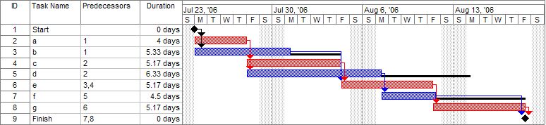
Gantt Chart: Example
Unit IV: Project Scheduling and Network Analysis
Once this step is complete, one can draw a Gantt chart or a network diagram
Note
(1) the critical path is in red, (2) the slack is the black lines connected to non-critical activities, (3) since Saturday and Sunday are not work days and are thus excluded from the schedule, some bars on the Gantt chart are longer if they cut through a weekend.
PROJECT MANAGEMENT
Notes:
The final stage in this process is to prepare a final version of the Gantt Chart. This should combine the draft analysis with your scheduling and analysis of resources. This chart will show when you anticipate that jobs should start and finish.

Slide 16
Unit IV: Project Scheduling and Network Analysis
Work Breakdown Structures
This is a technique to analyze the content of work and cost by breaking it down into its component parts. It is produced by :-
Identifying the key elements
Breaking each element down into component parts
Continuing to breakdown until manageable work packages have been identified. These can then be allocated to the appropriate person.
Below is a work breakdown structure for the recruitment of a new person to fill a vacant post.
PROJECT MANAGEMENT
Notes:
PERT is a variation on Critical Path Analysis that takes a slightly more skeptical view of time estimates made for each project stage. To use it, estimate the shortest possible time each activity will take, the most likely length of time, and the longest time that might be taken if the activity takes longer than expected.
Use the formula below to calculate the time to use for each project stage:

Slide 17
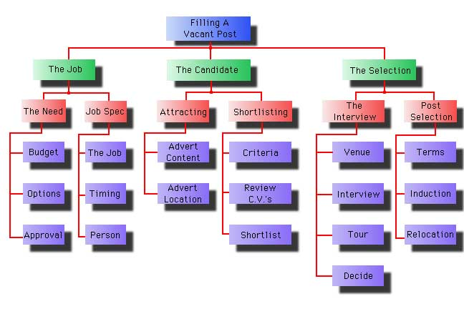
Unit IV: Project Scheduling and Network Analysis
Work Breakdown Structures
PROJECT MANAGEMENT
Notes:
PERT is a variation on Critical Path Analysis that takes a slightly more skeptical view of time estimates made for each project stage. To use it, estimate the shortest possible time each activity will take, the most likely length of time, and the longest time that might be taken if the activity takes longer than expected.
Use the formula below to calculate the time to use for each project stage:

Slide 18
Responsibility Assignment Matrix
Unit IV: Project Scheduling and Network Analysis
A Responsibility Assignment Matrix (RAM) describes the participation by various organizations, people and roles in completing tasks or deliverables for a project. It's used by the Program Manager (PM) in clarifying roles and responsibilities in cross-functional team, projects and processes.
A RAM is also called a Responsible, Accountable, Consulted, and Informed (RACI) matrix. The RACI matrix is a responsibility assignment chart that maps out every task, milestone or key decision involved in completing a project and assigns which roles are Responsible for each action item, which personnel are Accountable, and, where appropriate, who needs to be Consulted or Informed.
PROJECT MANAGEMENT
Notes:
Critical Path Analysis and PERT are powerful tools that help you to schedule and manage complex projects. They were developed in the 1950 to control large defense projects, and have been used routinely since then.
As with Gantt Charts, Critical Path Analysis (CPA) helps you to plan all tasks that must be completed as part of a project. They act as the basis both for preparation of a schedule, and of resource planning.
As with Gantt Charts, the essential concept behind Critical Path Analysis is that you cannot start some activities until others are finished. These activities need to be completed in a sequence, with each stage being more-or-less completed before the next stage can begin. These are 'sequential' activities.
Other activities are not dependent on completion of any other tasks. You can do these at any time before or after a particular stage is reached. These are non-dependent or 'parallel' tasks.

Slide 19
Responsibility Assignment Matrix
Unit IV: Project Scheduling and Network Analysis
Responsible: Those who do the work to achieve the task. There is typically one role with a participation type of Responsible, although others can be delegated to assist in the work required.
Accountable: The one ultimately accountable for the correct and thorough completion of the deliverable or task, and the one to whom Responsible is accountable. In other words, an Accountable must sign off (Approve) on work that Responsible provides. There must be only one Accountable specified for each task or deliverable.
Consulted: Those whose opinions are sought; and with whom there is two-way communication.
Informed: Those who are kept up-to-date on progress, often only on completion of the task or deliverable; and with whom there is just one-way communication.
PROJECT MANAGEMENT
Notes:
Critical Path Analysis and PERT are powerful tools that help you to schedule and manage complex projects. They were developed in the 1950 to control large defense projects, and have been used routinely since then.
As with Gantt Charts, Critical Path Analysis (CPA) helps you to plan all tasks that must be completed as part of a project. They act as the basis both for preparation of a schedule, and of resource planning.
As with Gantt Charts, the essential concept behind Critical Path Analysis is that you cannot start some activities until others are finished. These activities need to be completed in a sequence, with each stage being more-or-less completed before the next stage can begin. These are 'sequential' activities.
Other activities are not dependent on completion of any other tasks. You can do these at any time before or after a particular stage is reached. These are non-dependent or 'parallel' tasks.

Slide 20
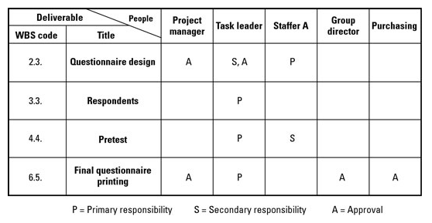
Responsibility Assignment Matrix: Example
Unit IV: Project Scheduling and Network Analysis
A RAM can define what a project team is responsible for within each component of the Work Breakdown Structure (WBS).
PROJECT MANAGEMENT
Notes:
Critical Path Analysis and PERT are powerful tools that help you to schedule and manage complex projects. They were developed in the 1950 to control large defense projects, and have been used routinely since then.
As with Gantt Charts, Critical Path Analysis (CPA) helps you to plan all tasks that must be completed as part of a project. They act as the basis both for preparation of a schedule, and of resource planning.
As with Gantt Charts, the essential concept behind Critical Path Analysis is that you cannot start some activities until others are finished. These activities need to be completed in a sequence, with each stage being more-or-less completed before the next stage can begin. These are 'sequential' activities.
Other activities are not dependent on completion of any other tasks. You can do these at any time before or after a particular stage is reached. These are non-dependent or 'parallel' tasks.

Slide 21
Network Design
Unit IV: Project Scheduling and Network Analysis
Network design is a category of systems design that deals with data transport mechanisms. As with other systems' design disciplines, network design follows an analysis stage, where requirements are generated, and precedes implementation, where the system (or relevant system component) is constructed.
PROJECT MANAGEMENT
Notes:
Critical Path Analysis and PERT are powerful tools that help you to schedule and manage complex projects. They were developed in the 1950 to control large defense projects, and have been used routinely since then.
As with Gantt Charts, Critical Path Analysis (CPA) helps you to plan all tasks that must be completed as part of a project. They act as the basis both for preparation of a schedule, and of resource planning.
As with Gantt Charts, the essential concept behind Critical Path Analysis is that you cannot start some activities until others are finished. These activities need to be completed in a sequence, with each stage being more-or-less completed before the next stage can begin. These are 'sequential' activities.
Other activities are not dependent on completion of any other tasks. You can do these at any time before or after a particular stage is reached. These are non-dependent or 'parallel' tasks.

Slide 22
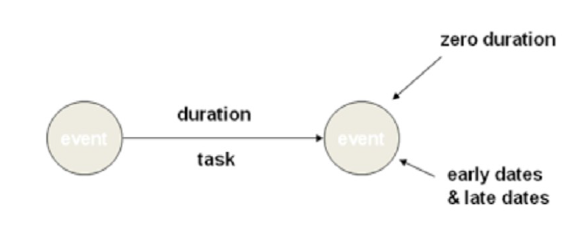
Project Network Diagrams AOA/AON
Unit IV: Project Scheduling and Network Analysis
A project network illustrates the relationships between activities / tasks in the project.
Showing the activities as nodes or on arrows between event nodes are two main ways to draw those relationships.
Two types of Network Logic:-
• Activity on Arrow (AOA)
• Activity on Node (AON)
PROJECT MANAGEMENT
Notes:
Critical Path Analysis and PERT are powerful tools that help you to schedule and manage complex projects. They were developed in the 1950 to control large defense projects, and have been used routinely since then.
As with Gantt Charts, Critical Path Analysis (CPA) helps you to plan all tasks that must be completed as part of a project. They act as the basis both for preparation of a schedule, and of resource planning.
As with Gantt Charts, the essential concept behind Critical Path Analysis is that you cannot start some activities until others are finished. These activities need to be completed in a sequence, with each stage being more-or-less completed before the next stage can begin. These are 'sequential' activities.
Other activities are not dependent on completion of any other tasks. You can do these at any time before or after a particular stage is reached. These are non-dependent or 'parallel' tasks.

Slide 23
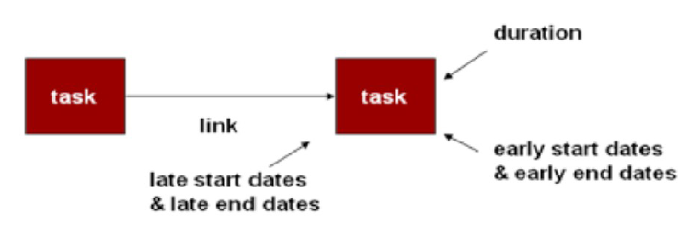
Project Network Diagrams AOA
Unit IV: Project Scheduling and Network Analysis
• With activities on arrow (AOA) diagrams, you are limited to showing only the finish to-start relationships.
• That is the arrow can represent only that the activity spans the time from the event at the start of the arrow to the event at the end.
• "Dummy" activities have to be added to show some of the more complex relationships and dependencies between activities.
• Arcs = only indicate activities
• Nodes = events (activity start or end)
• Popularity declining
• Difficult to draw, therefore not much SW support
• Requires dummy activities to model dependency relationships
PROJECT MANAGEMENT
Notes:
Critical Path Analysis and PERT are powerful tools that help you to schedule and manage complex projects. They were developed in the 1950 to control large defense projects, and have been used routinely since then.
As with Gantt Charts, Critical Path Analysis (CPA) helps you to plan all tasks that must be completed as part of a project. They act as the basis both for preparation of a schedule, and of resource planning.
As with Gantt Charts, the essential concept behind Critical Path Analysis is that you cannot start some activities until others are finished. These activities need to be completed in a sequence, with each stage being more-or-less completed before the next stage can begin. These are 'sequential' activities.
Other activities are not dependent on completion of any other tasks. You can do these at any time before or after a particular stage is reached. These are non-dependent or 'parallel' tasks.

Slide 24
Project Network Diagrams AON
Unit IV: Project Scheduling and Network Analysis
• Activity on Node (AON) diagrams place the activity on the node, and the interconnection arrows illustrate the dependencies between the activities.
• There are more flexible and can show all of the major types of relationships.
• Since the activity is on a node, the emphasis (and more data) usually can be
placed on the activity.
• Arcs = dependencies between activities. (Events not directly represented)
• Nodes = activities
• Popularity increasing
• Easy to draw, universal SW support (is a S/W tool)
• No artificial modelling constructs
The main difference between AOA & AON is AOA diagrams emphasize the milestones (events); AON networks emphasize the tasks.
PROJECT MANAGEMENT
Notes:
Critical Path Analysis and PERT are powerful tools that help you to schedule and manage complex projects. They were developed in the 1950 to control large defense projects, and have been used routinely since then.
As with Gantt Charts, Critical Path Analysis (CPA) helps you to plan all tasks that must be completed as part of a project. They act as the basis both for preparation of a schedule, and of resource planning.
As with Gantt Charts, the essential concept behind Critical Path Analysis is that you cannot start some activities until others are finished. These activities need to be completed in a sequence, with each stage being more-or-less completed before the next stage can begin. These are 'sequential' activities.
Other activities are not dependent on completion of any other tasks. You can do these at any time before or after a particular stage is reached. These are non-dependent or 'parallel' tasks.

Slide 25
Planning the Project:
Project Plans Critical Path Analysis
Unit IV: Project Scheduling and Network Analysis
Critical Path Analysis and PERT are powerful tools that help you to schedule and manage complex projects.
As with Gantt Charts, Critical Path Analysis (CPA) helps you to plan all tasks that must be completed as part of a project. They act as the basis both for preparation of a schedule, and of resource planning.
PROJECT MANAGEMENT
Notes:
Critical Path Analysis and PERT are powerful tools that help you to schedule and manage complex projects. They were developed in the 1950 to control large defense projects, and have been used routinely since then.
As with Gantt Charts, Critical Path Analysis (CPA) helps you to plan all tasks that must be completed as part of a project. They act as the basis both for preparation of a schedule, and of resource planning.
As with Gantt Charts, the essential concept behind Critical Path Analysis is that you cannot start some activities until others are finished. These activities need to be completed in a sequence, with each stage being more-or-less completed before the next stage can begin. These are 'sequential' activities.
Other activities are not dependent on completion of any other tasks. You can do these at any time before or after a particular stage is reached. These are non-dependent or 'parallel' tasks.

Slide 26
Critical Path Analysis
Unit IV: Project Scheduling and Network Analysis
Drawing a Critical Path Analysis Chart
1. List all activities in the plan
2. Plot the activities as a circle and arrow diagram
PROJECT MANAGEMENT

Slide 27
Critical Path Analysis
Unit IV: Project Scheduling and Network Analysis
1. List all activities in the plan
For each activity, show the earliest start date, estimated length of time it will take, and whether it is parallel or sequential. If tasks are sequential, show which stage they depend on.
PROJECT MANAGEMENT
Notes:
1. List all activities in the plan
For each activity, show the earliest start date, estimated length of time it will take, and whether it is parallel or sequential. If tasks are sequential, show which stage they depend on.
For the project example used here, you will end up with the same task list as explained in the article on Gantt Charts (we will use the same example as with Gantt Charts to compare the two techniques). The chart is repeated in Figure 1 below.

Slide 28
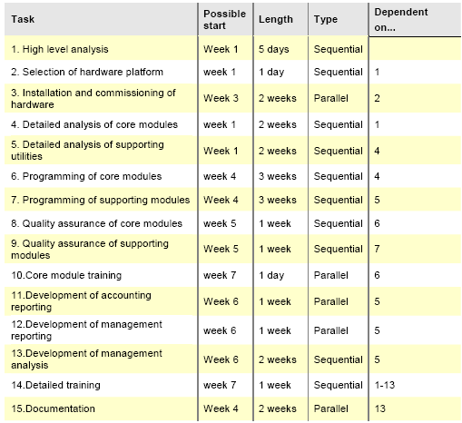
Example
Unit IV: Project Scheduling and Network Analysis
PROJECT MANAGEMENT

Slide 29
Critical Path Analysis
Unit IV: Project Scheduling and Network Analysis
2. Plot the activities as a circle and arrow diagram
Critical Path Analyses are presented using circle and arrow diagrams.
In these, circles show events within the project, such as the start and finish of tasks. Circles are normally numbered to allow you to identify them.
PROJECT MANAGEMENT
Notes:
Critical Path Analyses are presented using circle and arrow diagrams.
In these, circles show events within the project, such as the start and finish of tasks. Circles are normally numbered to allow you to identify them.
An arrow running between two event circles shows the activity needed to complete that task. A description of the task is written underneath the arrow. The length of the task is shown above it. By convention, all arrows run left to right.
An example of a very simple diagram is shown below:

Slide 30
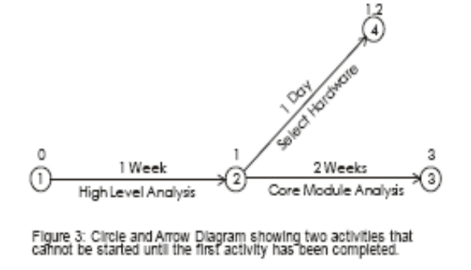
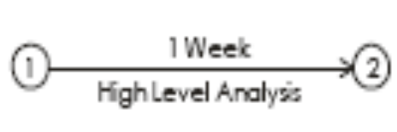
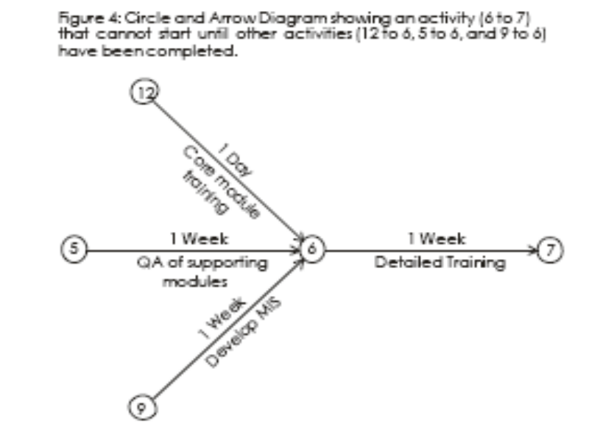
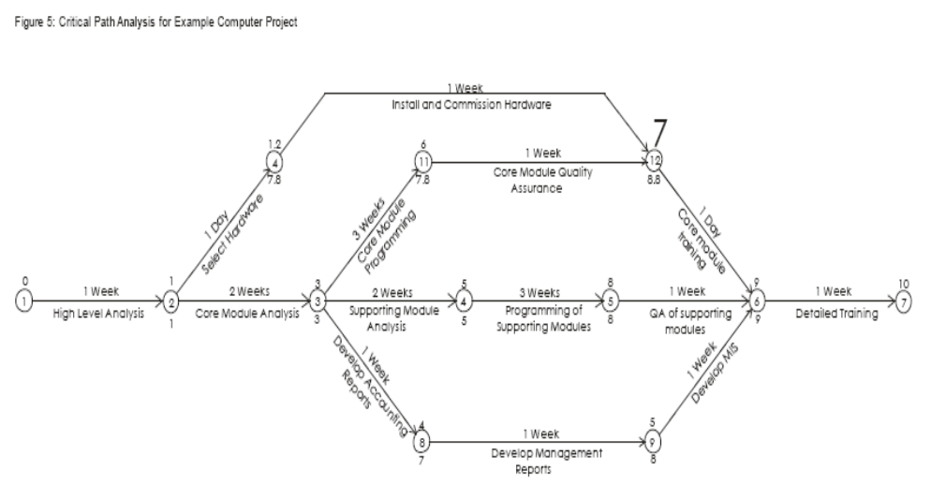
Critical Path Analysis
Unit IV: Project Scheduling and Network Analysis
Figure 2: Simple Circle and Arrow Diagram
PROJECT MANAGEMENT
Notes:
This shows the start event (circle 1), and the completion of the 'High Level Analysis' task (circle 2). The arrow between them shows the activity of carrying out the High Level Analysis. This activity should take 1 week.

Slide 31
Unit IV: Project Scheduling and Network Analysis
Critical Path Analysis
Crash Action
You may find that you need to complete a project earlier than your Critical Path Analysis says is possible. In this case you need to take action to reduce the length of time spent on project stages.
PROJECT MANAGEMENT
Notes:
You may find that you need to complete a project earlier than your Critical Path Analysis says is possible. In this case you need to take action to reduce the length of time spent on project stages. You could pile resources into every project activity to bring down time spent on each. This would probably consume huge additional resources.
A more efficient way of doing this would be to look only at activities on the critical path.
As an example, it may be necessary to complete the computer project in Figure 5 in 8 weeks rather than 10 weeks. In this case you could look at using two analysts in steps '2 to 3' and '3 to 4', and two programmers instead of one in step '4 to 5'. This would shorten the project by two weeks, but would raise the project cost – doubling resources at any stage often only improves productivity by, say, 50%. This occurs as time spent on coordinating the project consumes time gained by increasing resource.
Note that in this example, shortening the project by two weeks brings activities '3 to 11', '11 to 12' and '12 to 6' onto the critical path as well.

Slide 32
Unit IV: Project Scheduling and Network Analysis
PERT Analysis
Network analysis or PERT is used to analyze the inter-relationships between the tasks identified by the work breakdown structure and to define the dependencies of each task. Whilst laying out a PERT chart it is often possible to see that assumptions for the order of work are not logical or could be achieved more cost effectively by re-ordering them. This is particularly true whilst allocating resources; it may become self evident that two tasks cannot be completed at the same time by the same person due to lack of working hours or, conversely, that by adding an extra person to the project team several tasks can be done in parallel thus shortening the length of the project.
PROJECT MANAGEMENT
Notes:
PERT is a variation on Critical Path Analysis that takes a slightly more skeptical view of time estimates made for each project stage. To use it, estimate the shortest possible time each activity will take, the most likely length of time, and the longest time that might be taken if the activity takes longer than expected.
Use the formula below to calculate the time to use for each project stage:

Slide 33
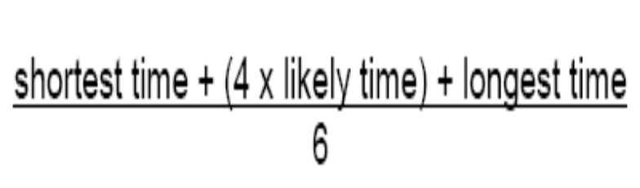
Unit IV: Project Scheduling and Network Analysis
PERT Analysis
PERT (Program Evaluation and Review Technique)
PERT is a variation on Critical Path Analysis that takes a slightly more skeptical view of time estimates made for each project stage.
Use the formula below to calculate the time to use for each project stage:
PROJECT MANAGEMENT
Notes:
PERT is a variation on Critical Path Analysis that takes a slightly more skeptical view of time estimates made for each project stage. To use it, estimate the shortest possible time each activity will take, the most likely length of time, and the longest time that might be taken if the activity takes longer than expected.
Use the formula below to calculate the time to use for each project stage:

Slide 34
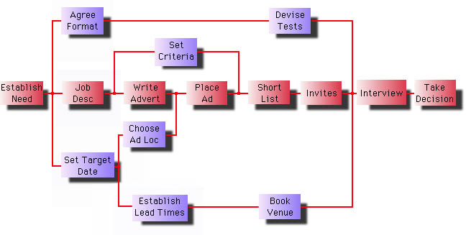
Unit IV: Project Scheduling and Network Analysis
PERT Analysis: Example
PROJECT MANAGEMENT
Notes:
PERT is a variation on Critical Path Analysis that takes a slightly more skeptical view of time estimates made for each project stage. To use it, estimate the shortest possible time each activity will take, the most likely length of time, and the longest time that might be taken if the activity takes longer than expected.
Use the formula below to calculate the time to use for each project stage:

Slide 35
Unit IV: Project Scheduling and Network Analysis
Crashing in Projects
Crashing is the technique to use when fast tracking has not saved enough time on the schedule. It is a technique in which resources are added to the project for the least cost possible. Cost and schedule tradeoffs are analyzed to determine how to obtain the greatest amount of compression for the least incremental cost.
The main reason for which project crashing is chosen is precisely to speed up its conclusion. If the end date of the project needs to be anticipated, the crashing allows you to get the most compression of the planning with the least impact and the lowest cost.
PROJECT MANAGEMENT
Notes:
PERT is a variation on Critical Path Analysis that takes a slightly more skeptical view of time estimates made for each project stage. To use it, estimate the shortest possible time each activity will take, the most likely length of time, and the longest time that might be taken if the activity takes longer than expected.
Use the formula below to calculate the time to use for each project stage:

Slide 36
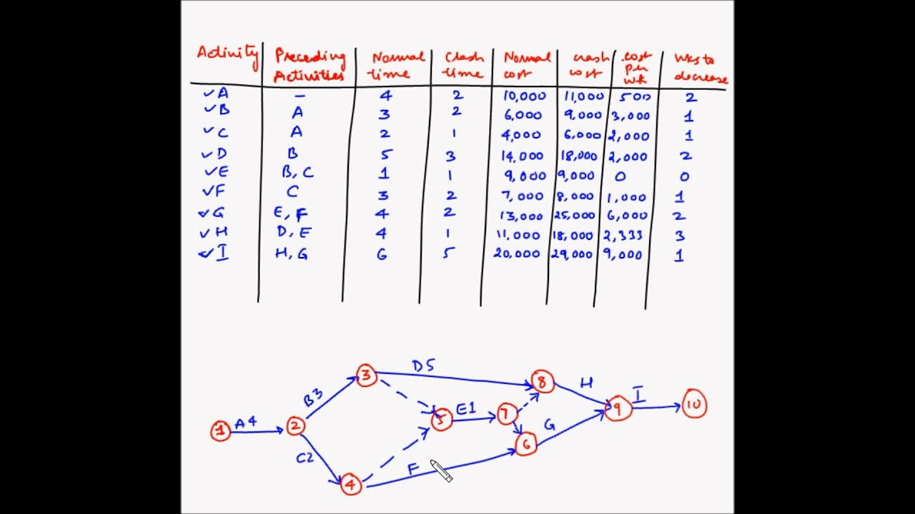
Unit IV: Project Scheduling and Network Analysis
Crashing in Projects
PROJECT MANAGEMENT
Notes:
PERT is a variation on Critical Path Analysis that takes a slightly more skeptical view of time estimates made for each project stage. To use it, estimate the shortest possible time each activity will take, the most likely length of time, and the longest time that might be taken if the activity takes longer than expected.
Use the formula below to calculate the time to use for each project stage:

Slide 37
THANKS
Unit IV: Project Scheduling and Network Analysis
END OF UNIT - IV
PROJECT MANAGEMENT

